Slide 1
Master Thesis Simon Nilsson & Tuong Lam
Neural network for fingerprint matching

Slide 2
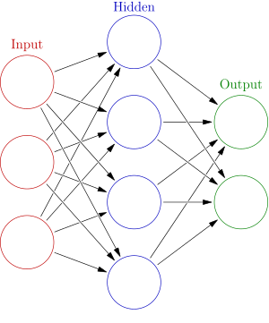
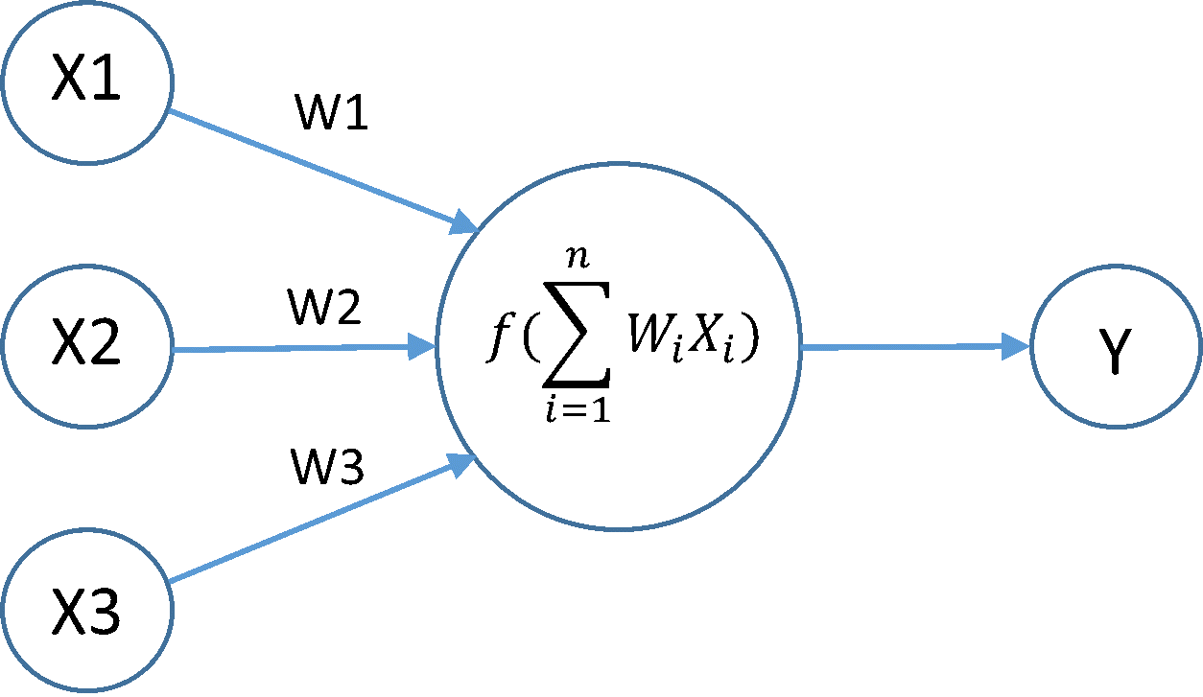
Artificial neural networks
A non-linear mapping from input to output
Uses nodes connected with weights in several layers
Train the weights
Activation function in each node determines its output

Slide 3
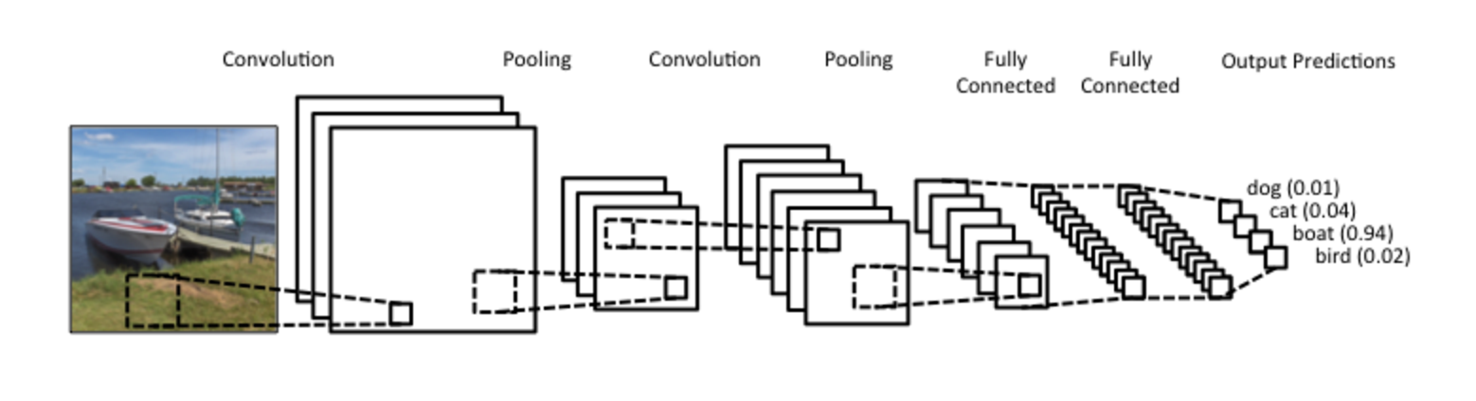
Convolutional Neural Network (CNN)
Convolutional filters are trained to detect features
Use many layers to capture complex structures
http://www.wildml.com/2015/11/understanding-convolutional-neural-networks-for-nlp/

Slide 4
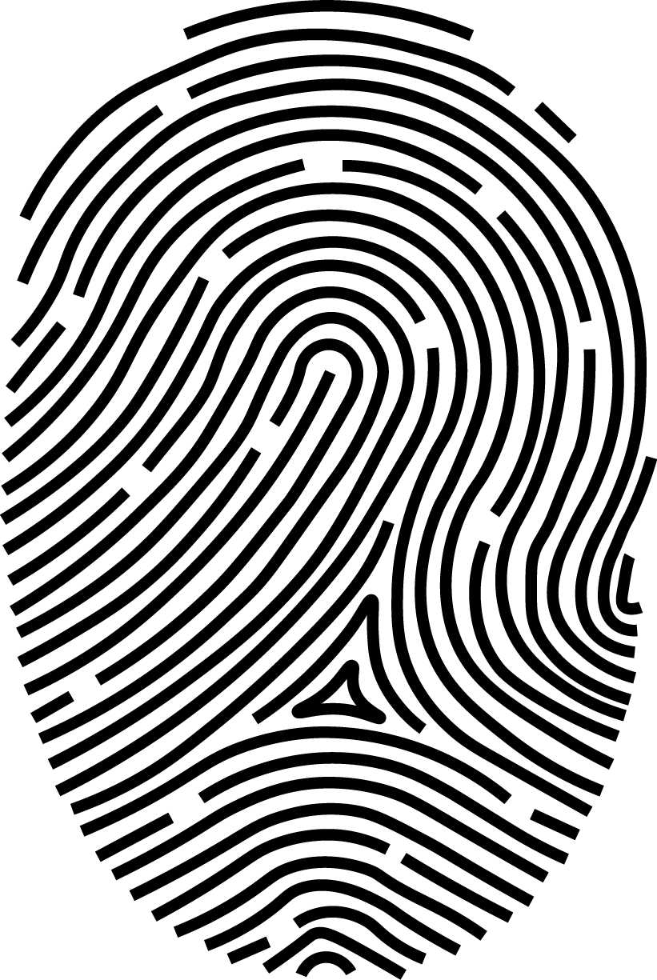
Proposed Architectures – Siamese network
CNN
Decision layer
Image 1
Match/No match
CNN
Image 2

Slide 5
Proposed Architectures – Loopy RNN
x₁
RNN Decision layer
Patch 1
CNN
Match/No match
x₂
CNN
Patch 2

